Slide 1

BI versus Relational Design
Understanding the key differences
Louis Davidson

Slide 2







Thanks to our sponsors
Please visit our sponsors!

Slide 3

And now… on with the show!

Slide 4
Bit of a warning…
This is the first time I have done (most of) this presentation

Slide 5
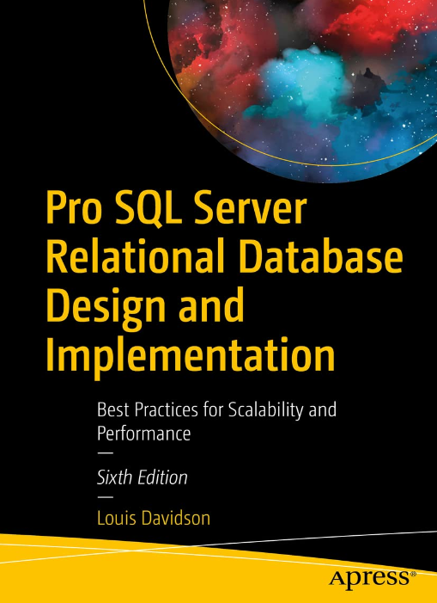
Who Am I?
Database programmer/architect > 30 years
Former Microsoft MVP (19 Times)
Written 6 books on database design
  They were technically all versions of the same book.
  They at least had slightly different titles each time
  Seventh Edition? Who knows?
Super Brief Contact Info: DRSQL
  Twitter, Website (.org), Email (@hotmail.com)
Simple-Talk.com Editor
Article writing interest?
  editor@simple-talk.com

Slide 6

My background

Slide 8




My non-tech hobby
Instagram: @figmentsintime
xTwitter: @dollywoodp
xTwitter: @disneypicaday

Slide 9
My professional background
Currently:
  Website editor for Simple Talk (owned by Redgate Software)
Before that, over 30 years as a little bit of a:
  DBA
  Transact SQL Programmer
  Data Architect
  ETL Developer
  Writer/blogger/speaker/learner about these topics
    Written several books on Relational Database Design (Last time I will mention this)
    Went to a few of the Kimball Group’s Classes

Slide 10

Why do we build databases to start with?
Help AI help us
Determine trends
Get paid for that action…
Record Some Activity
Follow Up
Immediately report that this action has occurred
Indirectly trigger actions to occur
Be prepared for audits
Notes:
Why do we build databases?
To allow high throughput of data being input.
Of course… but what good is data if it is stored poorly?
To DO things with the data
#1 to capture that an action has or has not occurred
Short term reports
Long term reports
Process returns
Prevent future issues
Marketing (which does sound better than advertising!)
#1 is generally the one that is truly treated as important as immediate questions are asked
Customer ordered product, didn’t get it
Why did’t customer get this email
Customer said if we send them another freaking email…

Slide 11
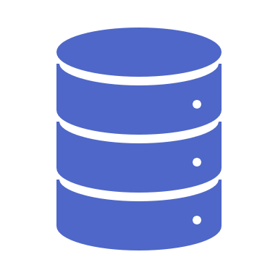
Similarities Between BI and Relational
Both are data stored to be used
  Often using the same data storage technologies
Both typically focus on table structures
  Rows, Columns with Scalar Values
Some of the core skills involved
  Relational Database Engines (Or something that behaves similarly)
  SQL
Most important similarity:
  Organizations rely on data from relational and business intelligence systems to make important decisions
  Data Quality is ESSENTIAL
These similarities are often the start of issues…

Slide 12
Difference: Purpose
Relational – Core Business Functions
Stores state information that reflects ongoing activities (such as sales and customer data).
Data storage usually necessitates ACID compliance (Atomicity, Consistency, Isolation, Durability)
Commonly associated with transactional systems (OLTP)
Usually accessed through a predetermined interface
Business Intelligence – Analysis and History
Converting transactional data into actionable insights
Commonly though of as analytics (OLAP)
Aimed at facilitating significant decision-making processes
Can include a computer interface or allow users to run queries directly using the database as an interface

Slide 13

Difference: The data
Relational: Live, frequently modified data
  Generally, we keep all states/actions/etc that have occurred
  With at least the data you need to serve users and keep work going
  May even be the legal documentation for actions (which can change retention rules)
Data Warehouse: Typically a copy of the data
  Kimball had a metaphor of a kitchen with 3 areas:
    Kitchen
      Prep area: no user access, but all the data you need to serve anyone
      Chef table: cleaned data, likely formatted. Some users get access, but it is a special, power user access only
    Dining Room: where data is served to the guests in the way they need it
  Fabric has the Medallion architecture
  Biggest thing is you keep copies of ALL the data the user may WANT to access.

Slide 14

Difference: Modeling approach
Relational:
  Things that exist
  Basically store the memory of a something or some process
  Goal is to match the design exactly to the customer’s real world
  Can be very complex, if the customer’s needs are complex
  Eliminate duplication to enhance integrity
Business Intelligence
  Actions you want to quantify
  Goal is to be able to answer the customer’s questions
  Tuning your design to their needs is not simple
  Allow duplication to enhance usability

Slide 15
Difference: Model Structures
Relational is based on Normalized Structures
  Eliminates redundancies at all levels
  Optimized for adding, modifying, and deleting data consistently
  Tables represent individual concepts (nouns) and relationships between them
Business Intelligence
  Data Warehouse
    Mix of data formats that you can pull data from/report from
  Dimensional Modeling
    Typical target format
  Star Schema
    Fact table: Basically a single answer to one or more core questions about an action (grain)
      Measures: Numeric details you can aggregate on
      Dimensions: Factors you can group the answers on
    Dimension Tables: Tables for more complex dimensions
  Snowflake Schema
    Star Schema with some normalization in the dimensions

Slide 16

Warning:
The next examples are very simplistic and for a brief description only. Your actual designs will be a lot more complex.

Slide 17
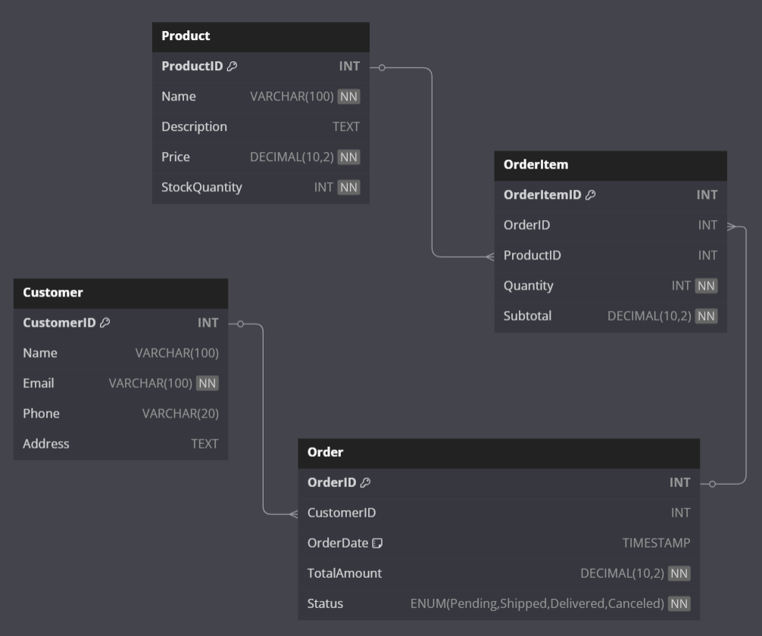
Model Example Relational

Slide 18
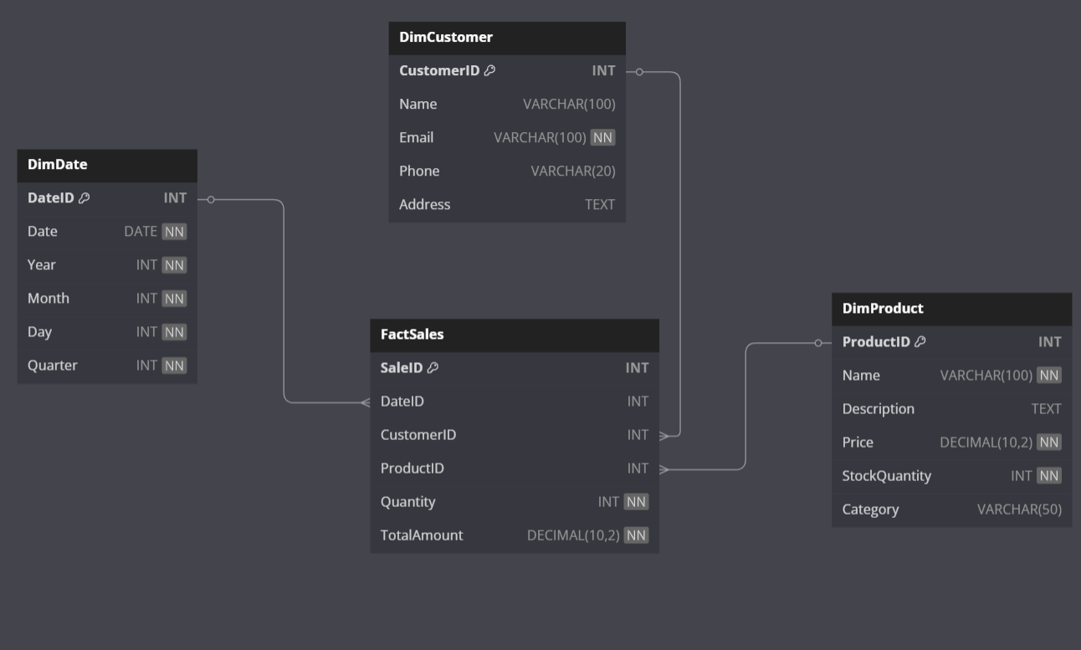
Model Example Dimensional

Slide 19
Difference: “Usually”
Usually:
  Does not apply to Relational Designs
  It does apply to Business Intelligence
Example “Our orders usually only have one item per order”
  Relational:
    If it CAN occur, it MUST be in the model
    We never model separate structures for the “exceptions”
  BI:
    Make sure questions can be answered correctly
    Different questions using the same data MAY result in new structures

Slide 20
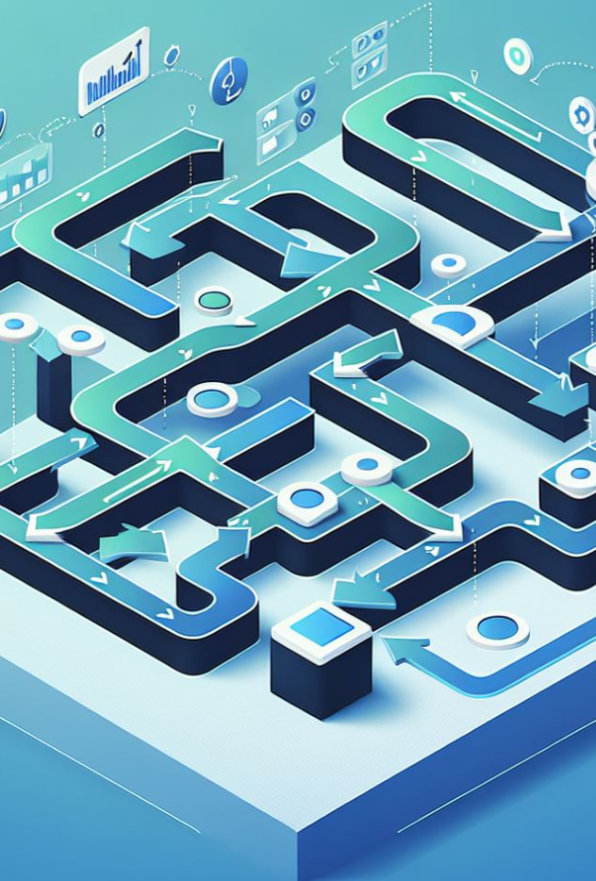
Difference: Normalization
I don’t like the notion that Dimensional Models are DENORMALIZED
Both typically do First Normal Form
  Each table represents one concept
  Each row represents one unique example of that concept
  Each column represents one aspect about that what the row represents
From there, they diverge:
  Relational: All about breaking things down and avoiding duplication
  Dimensional: Answering the questions easily and quickly is what matters. Controlled duplication is acceptable, even desirable.

Slide 21

My Biggest Mistake

Slide 22
In conclusion
Relational Database Model State
Dimensional Databases Model Activities
Data Warehouses May Include A Bit of Both
If something MAY occur, it:
Must be modeled in your Relational Databases
Only needs to be understood in your output for Business Intelligence Databases

Slide 23

That’s it, time to wake up..

Slide 24


Questions? Contact info..
Louis Davidson - louis@drsql.org
Website – http://drsql.org
  Get slides here: https://drsql.org/presentations
Twitter – http://x.com/drsql
Editor/Blogger at
https://www.red-gate.com/simple-talk/author/louis-davidson/
(Always looking for new writers! editor@simple-talk.com)
Notes:
[twitter] Slides will be on drsql.org in the presentations area for this and the keynote as soon as I can get them out there. @rmtechtrifecta [/twitter]

Slide 25
Thank you!
https://drsql.org/presentations

